Slide 1

Title of Project : Story Generator Using AI
JSPM’s
Rajarshi Shahu College of Engineering, Tathawade, Pune
(An Empower Autonomous Institute under Savitribai Phule Pune University)
Department of Computer Science and Business Systems
Artificial Intelligence Mini Project
AY-2025-26
Student Name:
1.Akshata Babasaheb Kamble
2.Mayuri Kiran Bidkar
Faculty Name: Hemlata Mane

Slide 2
Introduction
Objective of the Project:
The main objective of the AI Story Generator is to create an intelligent storytelling system that generates creative, engaging, and meaningful stories based on user input.
Users provide a few keywords (2–5 words) and select a theme, and the AI automatically generates a unique story using natural language processing (NLP) techniques.
This project aims to enhance creativity, imagination, and writing inspiration through the power of artificial intelligence.
Scope:
The project focuses on developing an interactive web-based application using Flask that allows users to generate stories in real time.
The system supports multiple genres such as adventure, fantasy, mystery, romance, and sci-fi. It can be extended further to include features like story continuation, saving favorite stories, and text-to-speech conversion.
Mapping With SDG Goal:(Provide Name of SDG goal to Which project Maps)
SDG Goal 4 – Quality Education
Key Features:
AI-Based Story Generation: Generates original stories using user-input keywords and selected themes.
Multiple Story Themes: Includes themes like fantasy, mystery, romance, adventure, and more.
User-Friendly Interface: Simple and responsive web UI built using Flask and HTML/CSS.
Real-Time Generation: Instantly produces a story using AI when the user submits input.
Customizable Length: Option to generate short or long stories.

Slide 3
Algorithm Used
Chosen Algorithm:
Natural Language Processing (NLP) using Pre-trained Transformer Model (GPT-based model)
Reason for Selection:
Capable of understanding user input (2–5 words) and generating meaningful, creative, and grammatically correct stories.
Requires minimal training — uses pre-trained AI language model through API for faster and more accurate text generation.
Advantages:
Efficient performance for real-time text generation.
Easy to implement basic operations like generating, saving, and displaying stories.

Slide 4
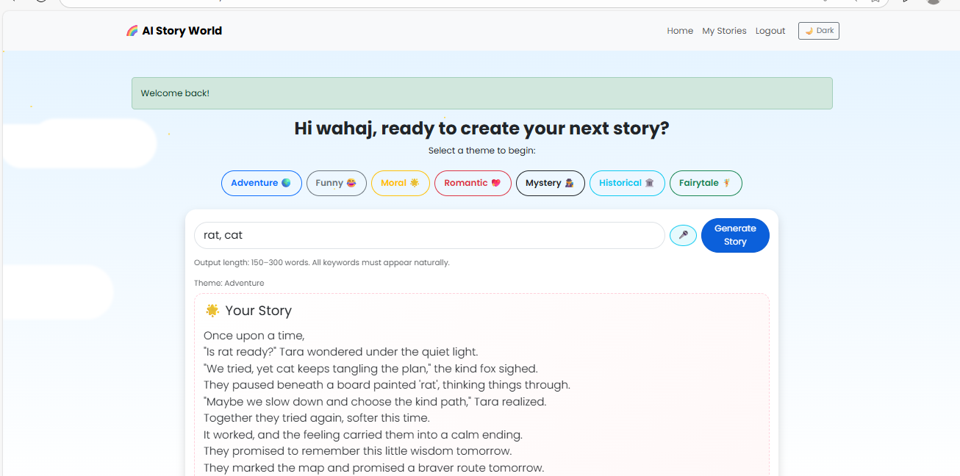
Module
List of Module( Provide implementation also)
1. User Input Module
2. Story Generation Module
3. Story Display Module
4. Save Story Module
5. Read/History Module (Optional)

Slide 5
Methodology & Results
• Methodology:
1. Problem analysis
2. Algorithm design & coding
4. Testing & validation
• Results & Conclusion:
- Efficient storage & retrieval of book data
- Future scope: GUI integration, database connectivity

Slide 6
References

